Slide 1
Employee performance analysis using excel
PRESENTED BY :DILLI GANESH B
REGISTER NO : 312204455, 075E2A2137070B6922F4A9BC806A4EFB
DEPARTMENT : COMMERCE
COLLEGE : K.C.S KASI NADAR COLLEGE OF ARTS & SCIENCE

Slide 2
PROJECT TITLE
EMPLOYEE SATISFACTION USING POWER QUERY

Slide 3
AGENDA
PROBLEM STATEMENT
PROJECT OVERVIEW
END USER
OUR SOLUTION AND PROPOSITION
DATASET DESCRIPTION
MODELING APPROACH
RESULTS AND DISCUSSION
CONCLUSION

Slide 4
PROBLEM STATEMENT
Analysis And Improve Employee Satisfaction Using Power Query Integrate And Clean Data From Multiple Sources Categorize Qualitative Responses And Identify Trends Deliver Interaction Dashboards In Power Bi To Visualize Key Metrics And Trends Provide Actionable Insights To Address Areas Of Concern And Improve Satisfaction

Slide 5
Project overview
This project aims to enhance employee satisfaction by utilizing power query to efficiently process and analysis data collected from various sources such as survey and hr records the project will involve integrating cleaning and categorizing the data to create a unified data set

Slide 6
Who are the end users ?
HR professionals
Management and leadership teams
Team leaders and departments
Data analysts
Employee

Slide 7
Our solution and its value proposition
Filtering – remove missing values
Pivot table- summary of employee performance
Formulas- IFS
Graphs- final report

Slide 8
Data description
Employee ID: Unique identifier of each employee
Department : states which department the employee belongs too
Recruitment source: this tells if the employees job requires him/her to travel to other places (Yes/No)
Satisfaction: a measure of employee satisfaction from surveys

Slide 9
MODELLING
Data set – kaggle ,employee dataset
Feature selection
Data cleaning: missing values irrelevant
Formula : performance calculation low med high
Pivot table summary business, unit, gender, employment type,employee id,
Performance
Chart : report: slicer

Slide 10
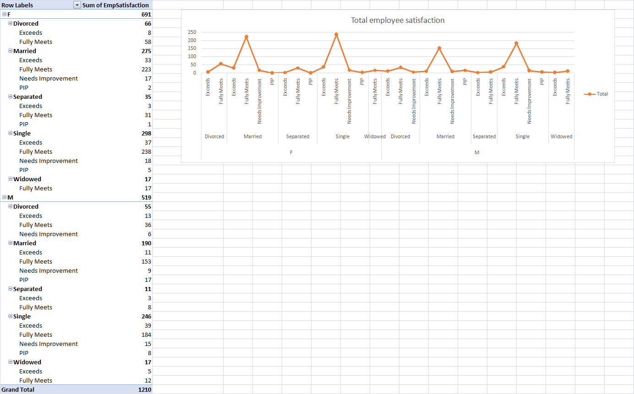
result

Slide 11
CONCLUSION
The data reveals a general trend in employee satisfaction across various departments and demographics. For instance, specific department or group] shows higher satisfaction levels compared to another department or group, which may suggest differences in work environment or management practices.

